Slide 1
CODES AND CONVERSION

Slide 2
1.9 CODES
When numbers, letters or words are represented by a special group of symbols (we call it encoding /encoded), the group of symbols is called a code.
Coded messages keeps your info secret.

Slide 3
When codes are used or why they are used:-
To allow computer to perform fast calculation at high speed with more precision and less hardware.
Computers understand binary language but external words are decimal in nature. Thus there is need of conversion from decimal to binary and vice-versa are long and complicated for large numbers. Thus coding is required.
Computers also deals with alphabets, punctuation marks and other special characters. To allow computers to handle all these information we have to use codes. These codes are called alphanumeric codes.

Slide 4
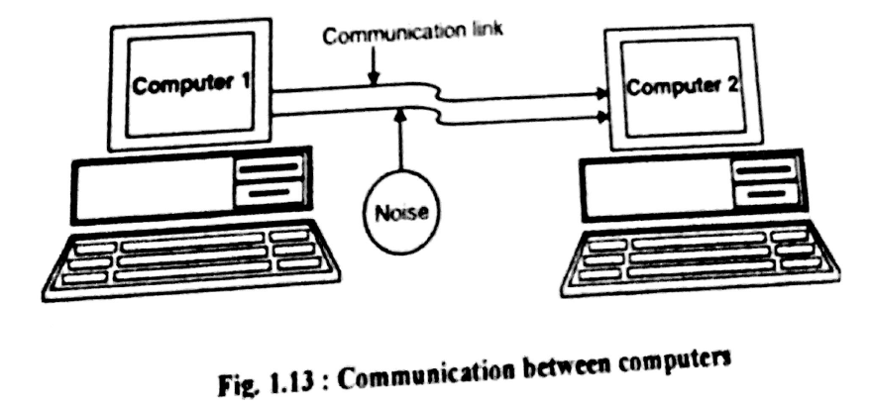
4. Because of noise corrupted data is received at the receiver end of the computer. Therefore there has to be some means by which comp can detect and correct the error and if possible delete the error. Thus, error correcting codes are used.

Slide 5
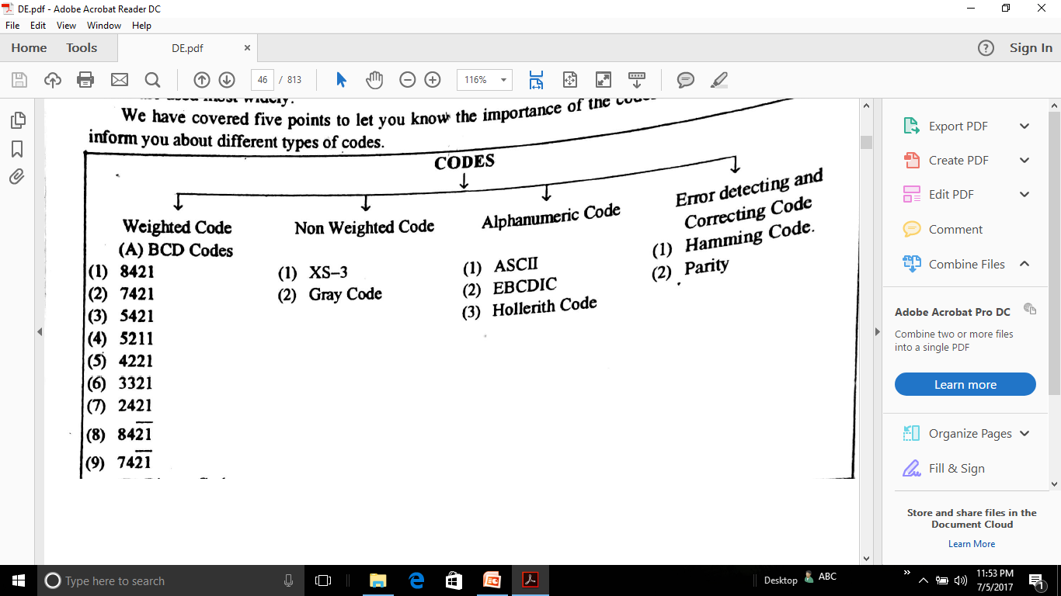

Slide 6
1.10 WEIGHTED CODE
BCD ( Binary Coded Decimal )
0-9 represented by a string of 4 bits
DECIMAL NUMBER | 8 | 4 | 2 | 1 | BCD
0 | 0 | 0 | 0 | 0 | 0
1 | 0 | 0 | 0 | 1 | 1
2 | 0 | 0 | 1 | 0 | 2
3 | 0 | 0 | 1 | 1 | 3
4 | 0 | 1 | 0 | 0 | 4
5 | 0 | 1 | 0 | 1 | 5
6 | 0 | 1 | 1 | 0 | 6
7 | 0 | 1 | 1 | 1 | 7
8 | 1 | 0 | 0 | 0 | 8
9 | 1 | 0 | 0 | 1 | 9

Slide 7
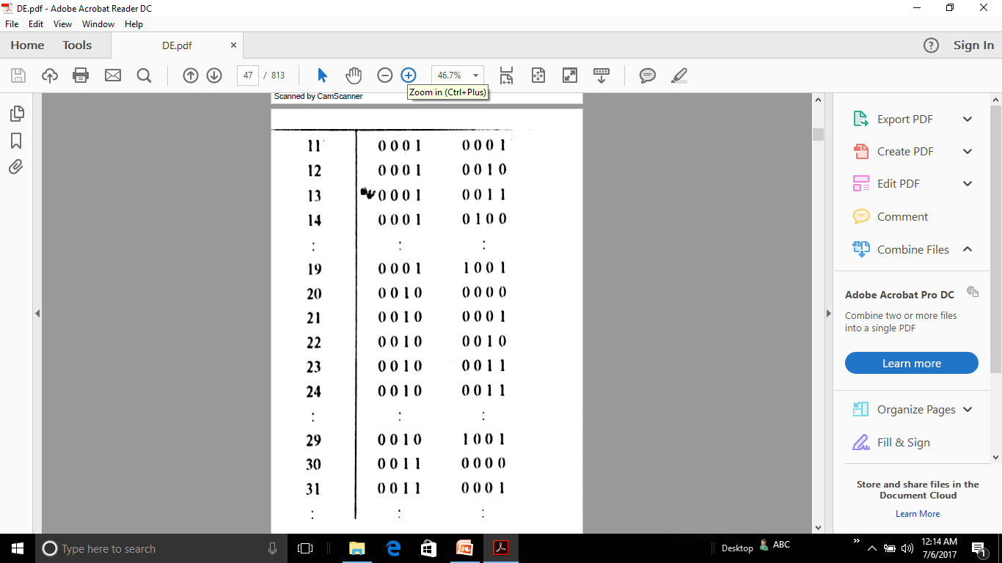
DECIMAL | 8 4 2 1 | 8 4 2 1 | BCD

Slide 8
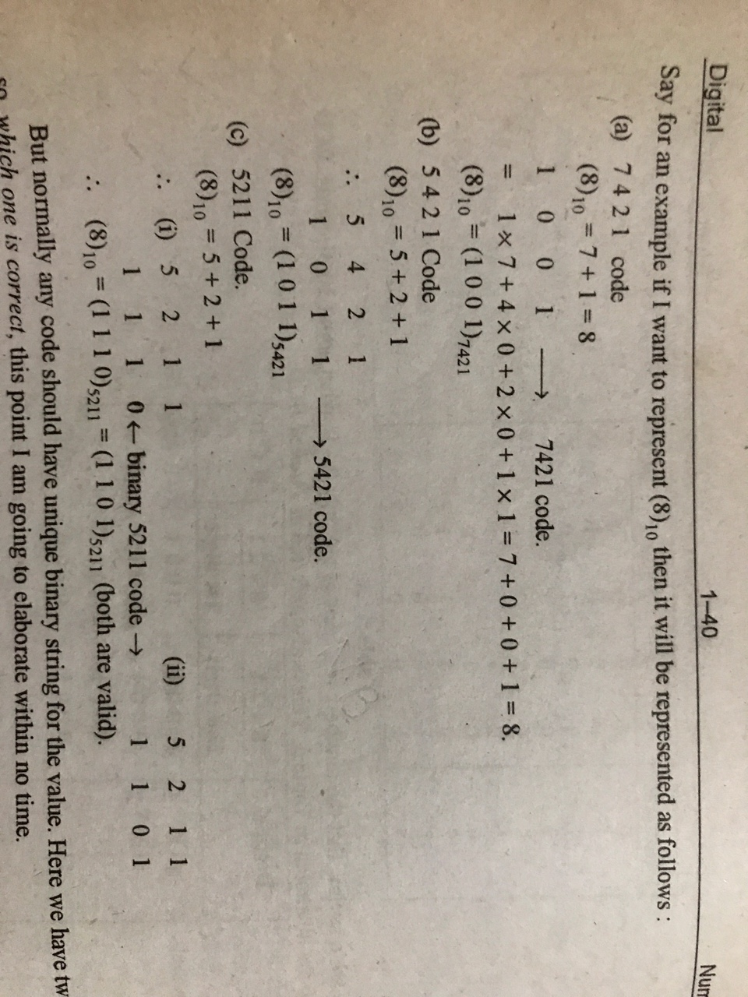

Slide 9
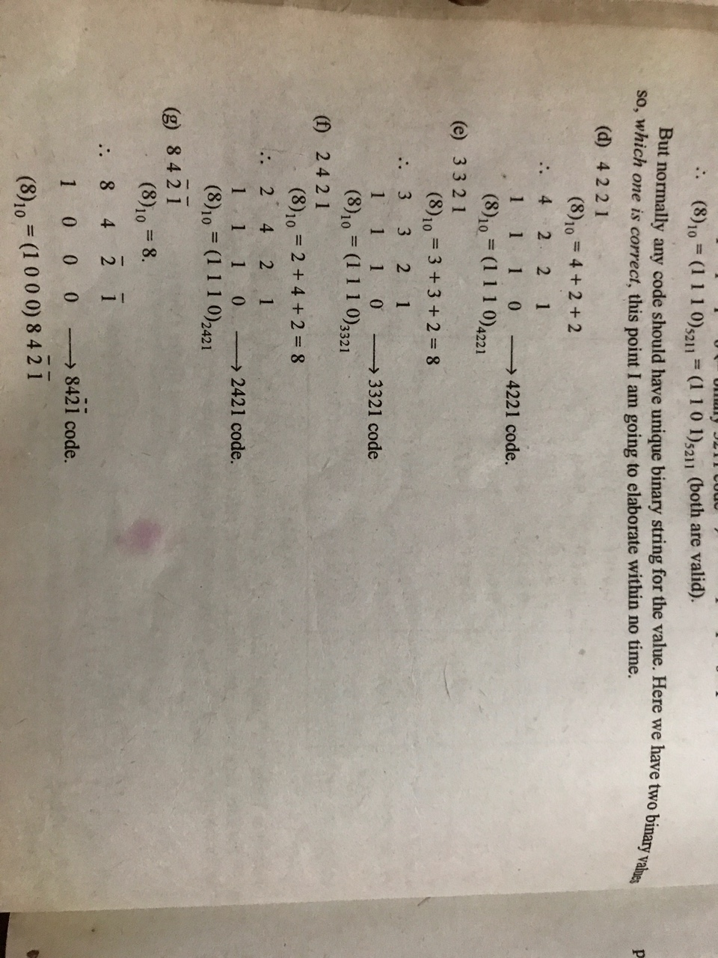

Slide 10
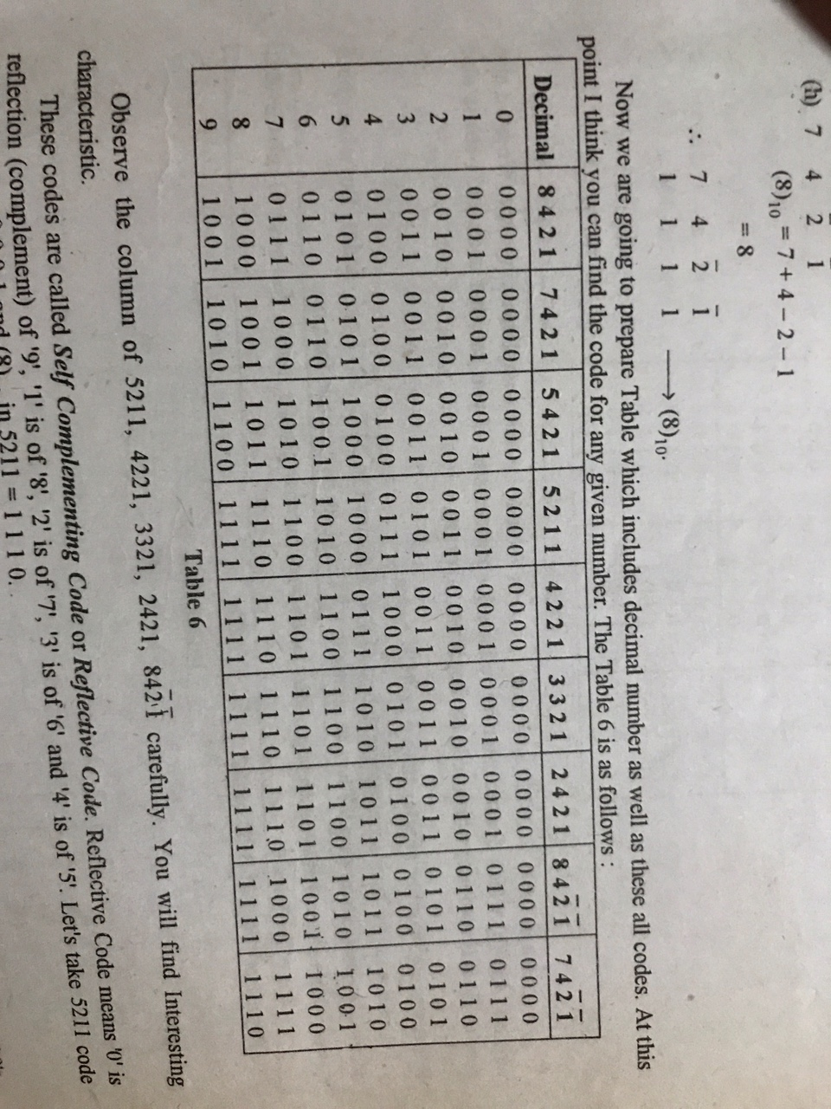

Slide 11
1.11 NON-WEIGHTED CODES
Excess-3 (XS-3) Code- related to BCD and is used instead of BCD sometimes because it has advantages in certain arithmetic operations.
(3)10 is added to each decimal digit before encoding it in binary.

Slide 12
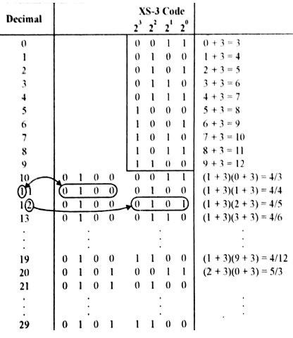

Slide 13
2. GRAY CODE-
New code differs
from the
previous in
terms of one
single bit.
DECIMAL | BINARY | GRAY
0 | 0000 | 0000
1 | 0001 | 0001
2 | 0010 | 0011
3 | 0011 | 0010
4 | 0100 | 0110
5 | 0101 | 0111
6 | 0110 | 0101
7 | 0111 | 0100
8 | 1000 | 1100
9 | 1001 | 1101
10 | 1010 | 1111
11 | 1011 | 1110
12 | 1100 | 1010
13 | 1101 | 1011
14 | 1110 | 1001
15 | 1111 | 1000

Slide 14
1.12 ALPHANUMERIC CODES
ASCII CODE (KEY)- introduced in 1963 an widely used in computers. Its 7 bit code thus provide 2^7=128 bit patterns.

Slide 15
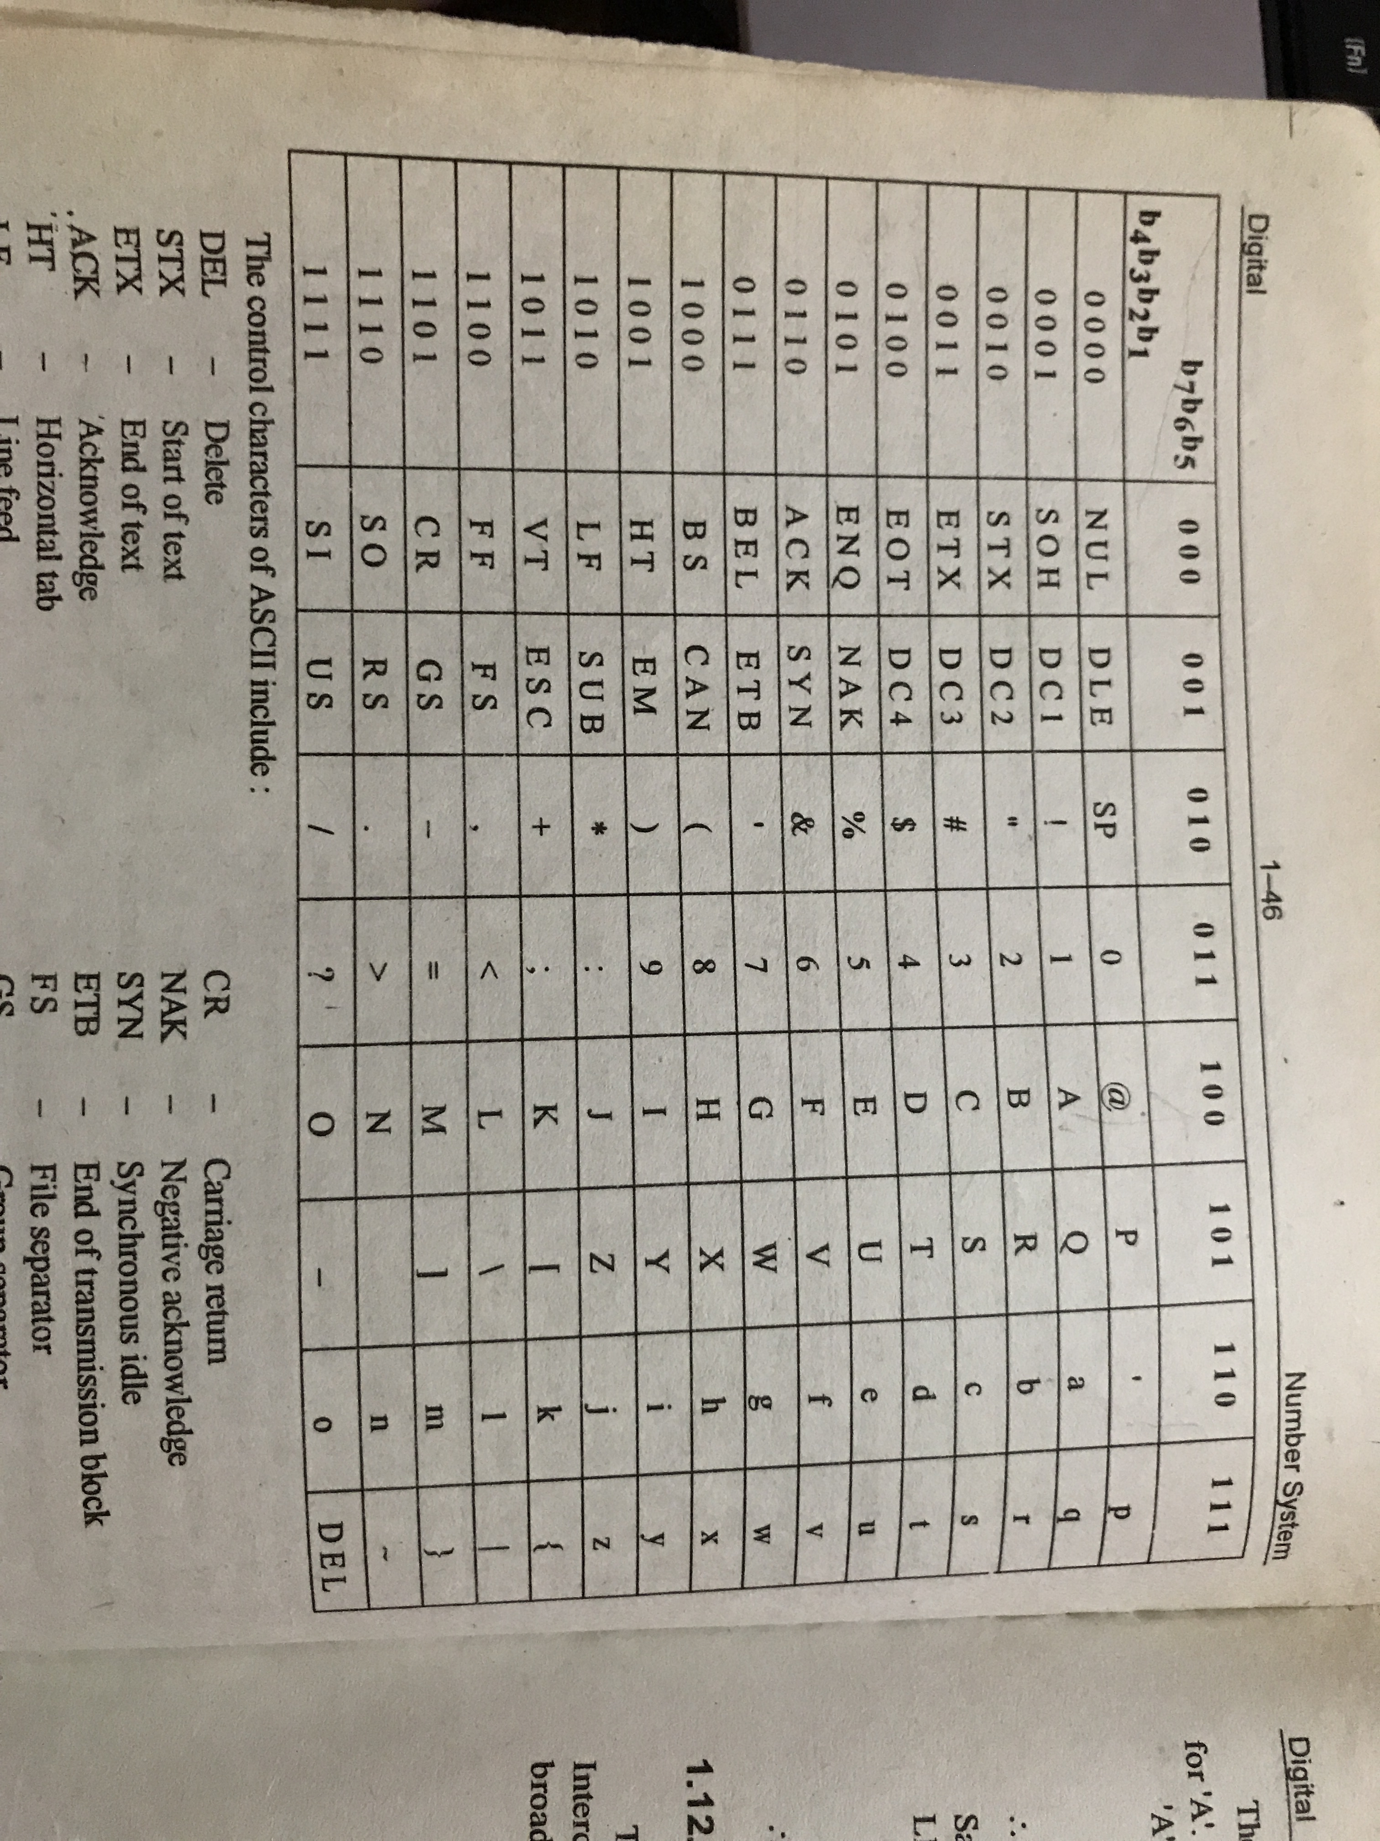

Slide 16
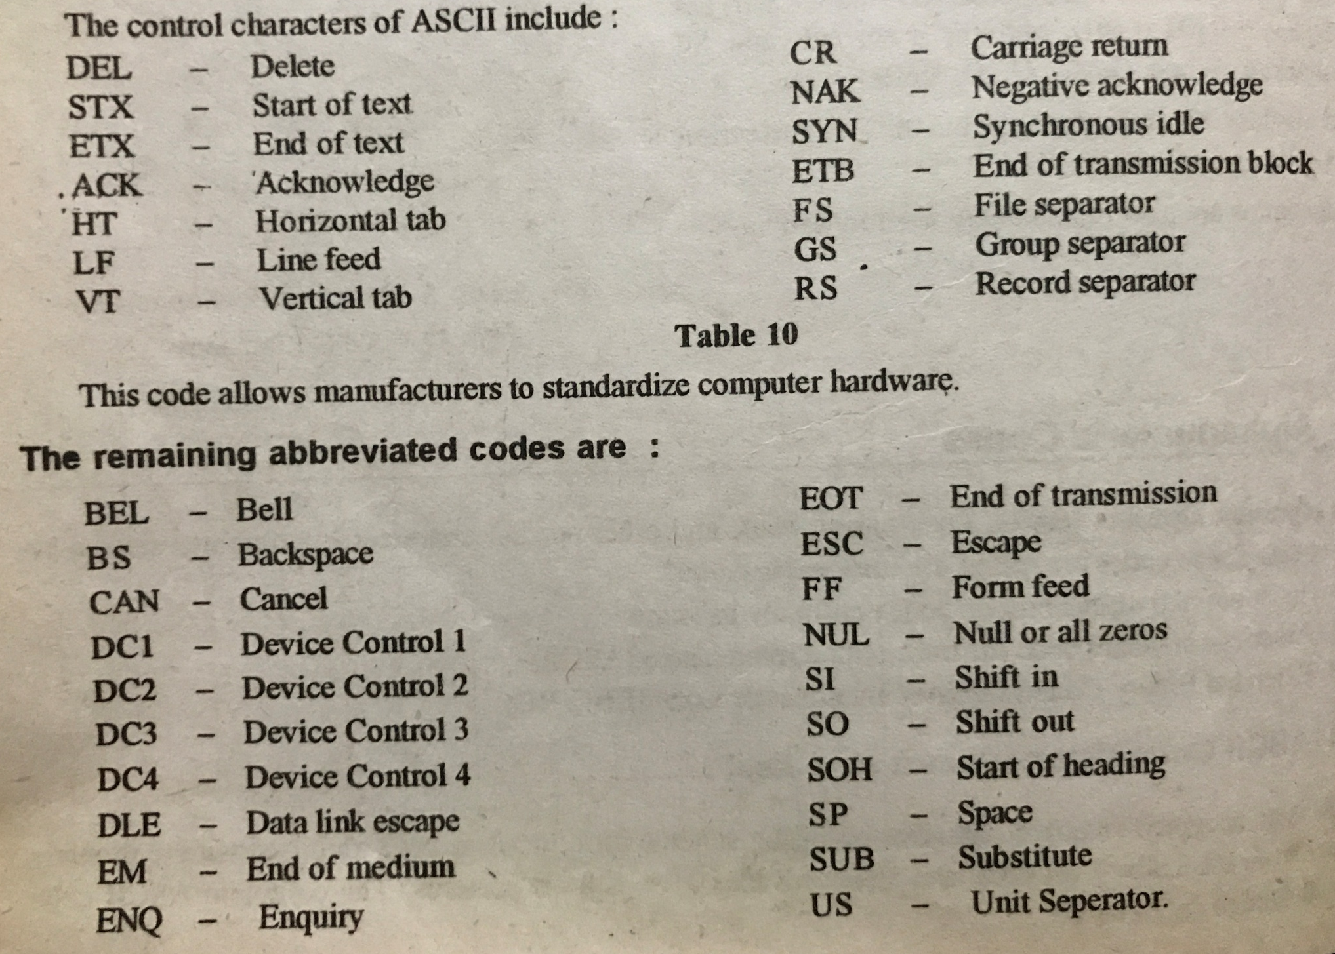

Slide 17
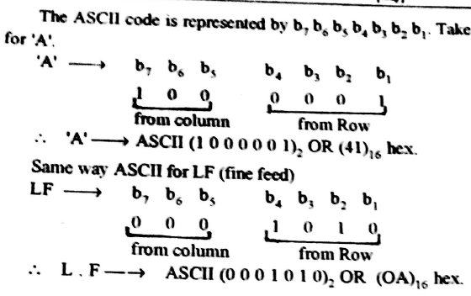

Slide 18
1.12.2 EBCDIC
This character code was developed by IBM.
Extended Binary Coded Decimal Interchange code.
8 bits code thus 2^8=256 character set. Similar to ASCII.9

Slide 19
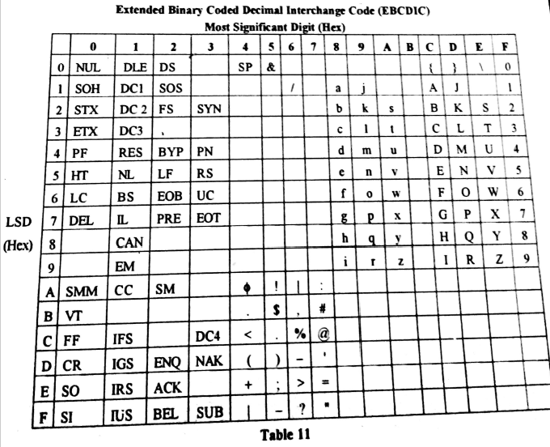

Slide 20
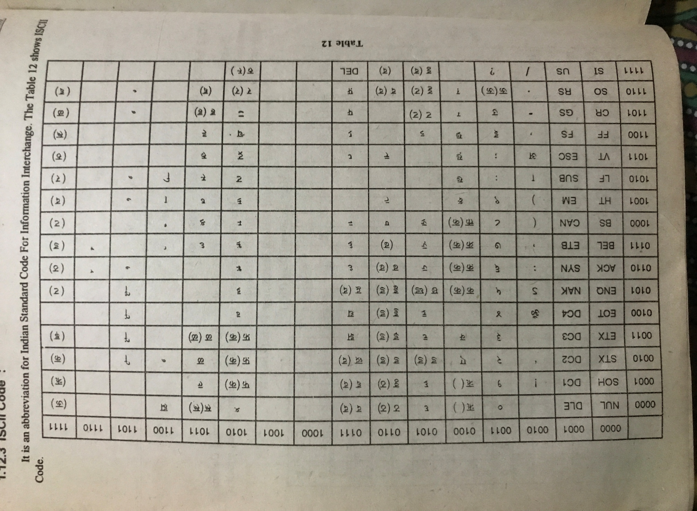
1.12.3 ISCII CODE
Indian Standard Code For Information.

Slide 21
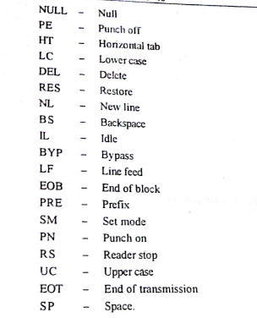

Slide 22
1.12.4 HOLLERITH CODE
Presently for storing data floppy, hard disk etc are used.
But before these devices, for storing the data punch card was used.

Slide 23
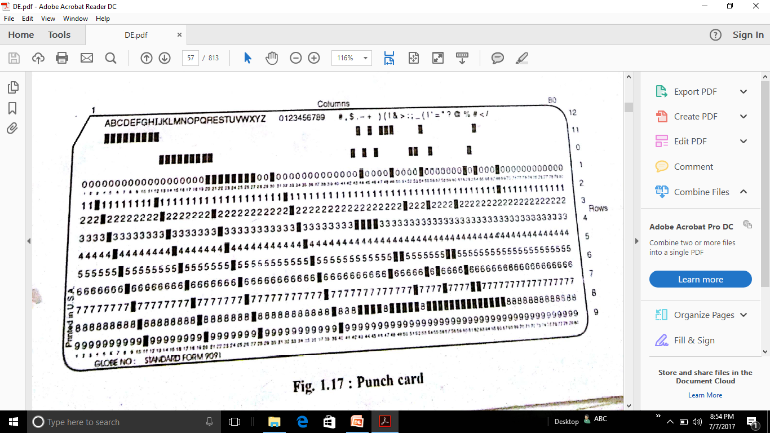

Slide 24
Card has 80 columns, oriented vertically and 12 rows oriented horizontally.
The rows are numbered 0 through 9, 11 and 12 and columns are numbered 1-80, each one contains one character.
Each character is identified by the rows punch in that column.
Eg- letter B is 12 – 2 punch i.e punch in 12th row and punch in 2nd row. Hollerith code is BCD code.

Slide 25
1.12.5 MORSE CODE ( TELEGRAPH CODE)
In olden days morse code was of great imp and used in millitary.
Developed by Samuel F. B. Morse, the American inventor of Telegraph.
This code uses ‘dashes’ and ‘dots’ to encode each letter.
Shortest code to freq used letters like E, T, A, I, N, M etc.
Two standards. International Morse Code was used for radio tx.

Slide 26
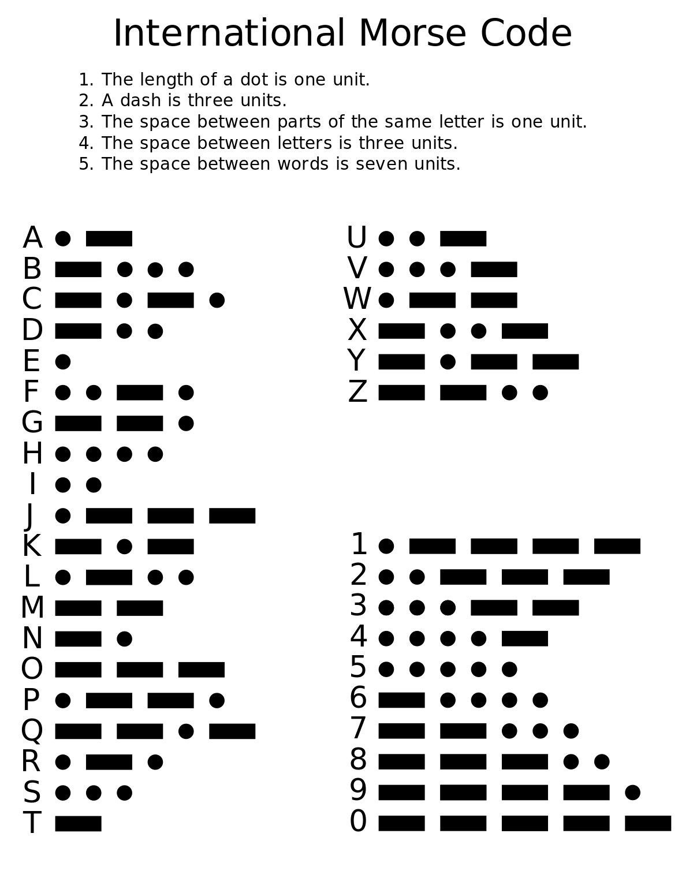

Slide 27
1.12.6 TELETYPEWRITER (TTY)
Most widely used i/p-o/p unit for large time shared computers, minicomputers and microcomputer.
TTY has keyboard for entering data & program. It has printing mechanism to get ans out of comp.
Equipped with paper tape punch to record i/p & o/p on paper tape.
It is 5 bit code. Used in Telex s/m.

Slide 28
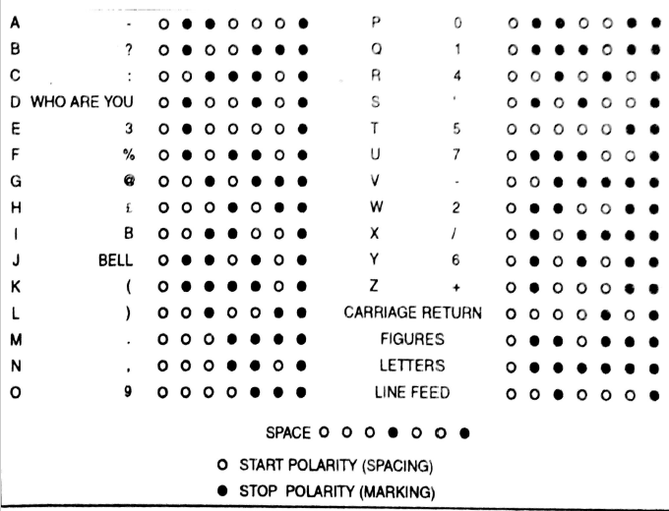

Slide 29
1.13 ERROR DETECTING & CORRECTING CODE-
Movement of binary data-
1. Communication b/w comp.
2.Storage and retrieval of data from floppy, hard disk, tape etc.
We pass data/info from tx-rx. We expect that the data accepted by rx should be identical/similar to that of send by tx.
But ideal condition is not achieved due to electrical noise(EMI-RFI interference)

Slide 30
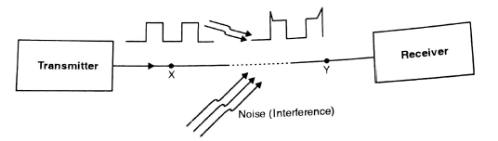
If the amplitude of noise is large enough than it can change the binary bits, or the data bits will be wrongly interpreted by rx end.
So in digital s/m we should have some means to detect error. Simplest and most widely used scheme for error detection is parity.

Slide 31
1.13.1 PARITY BIT
Parity bit is an extra bit that is attached to a code that is being transferred.
The parity bit can be either 0 or 1 depending upon the no. of 1’s contained in that code.
Two types of parity-
Even.
Odd.
N.B pg no 26,27

Slide 32
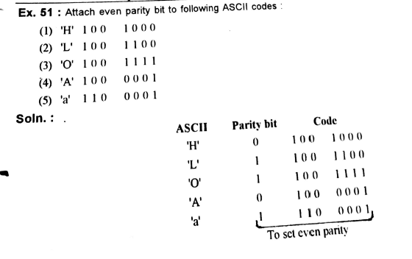

Slide 33
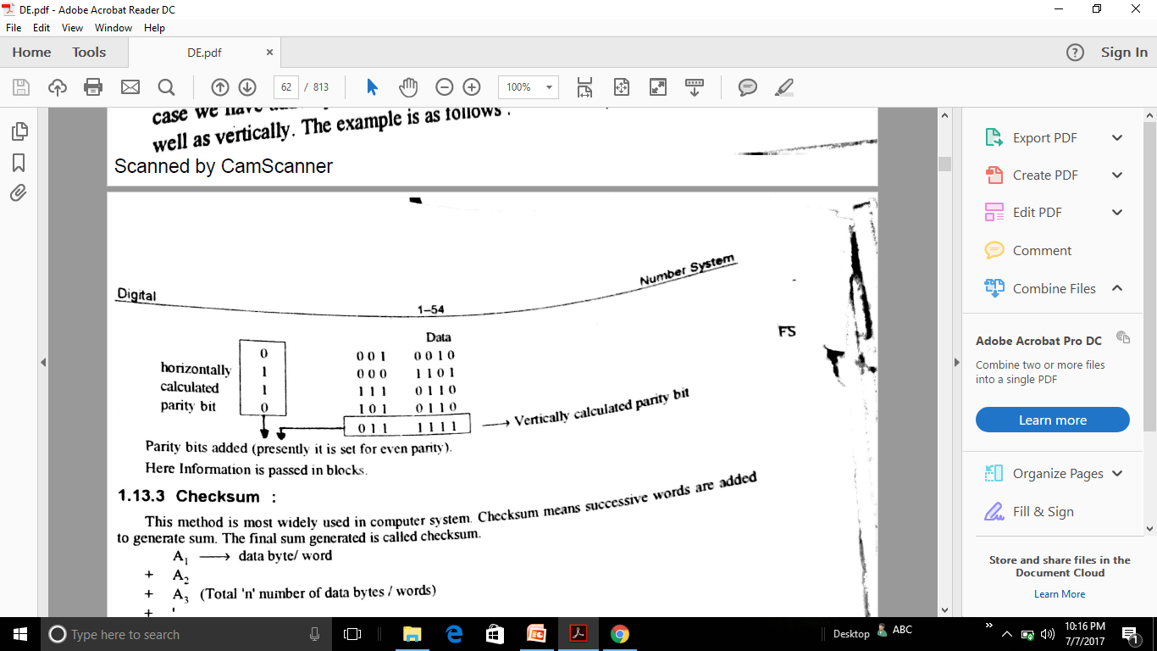
1.13.2 DOUBLE PARITY
In previous method parity bit is added horizontally only. In double parity, parity bit is added horizontally as well as vertically.

Slide 34
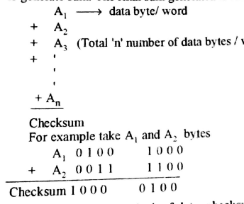
1.13.3 CHECKSUM
Widely used in computers. Checksum means successive words are added to generate sum. The final sum generated is called checksum.

Slide 35
After tx block of data, checksum is txtd to the rx.
On the rx side the rx data is added up to get checksum. This checksum should exactly match with checksum txtd by tx.

Slide 36
1.13.6 ERROR CORRECTING CODES:
Efficient method would be not only detecting error but also correcting it.
Popular error correcting code is Hamming Code. Discovered by R. W. Hamming in 1950.
Its uses parity bit, set for even parity over selected bits.
Parity bits are set at positions of 2^0, 2^1,…..2^n
7 bit Hamming code format:- D7 D6 D5 P4 D3 P2 P1

Slide 37
D7 D6 D5 P4 D3 P2 P1-
Where D= (4) data bits, D7= MSB, D3= LSB.
P= (3) parity bits, P4, P2,P1.
This is also called (7,4) hamming code. Normally it is represented by (n,k).
Where n= total no. of bits.
k= total no. of data bits.
Thus, m=n-k= no. of parity bits.
i.e n=7, k=4, m=n-k= 7-4= 3, m=3.
N.B pg no 27,28,29

Slide 38
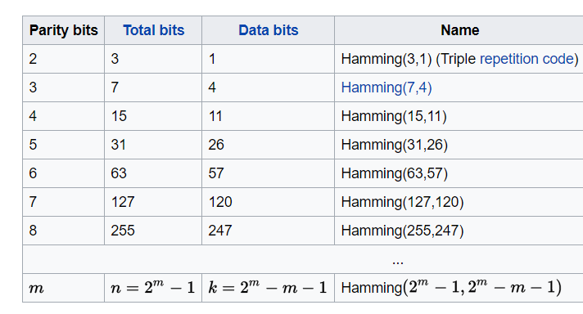

Slide 39
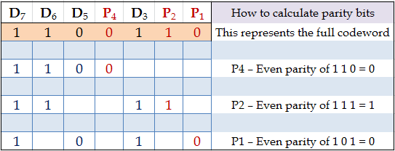
How to set parity bits
P1
D3
D5
D7
P2
P3
D6

Slide 40
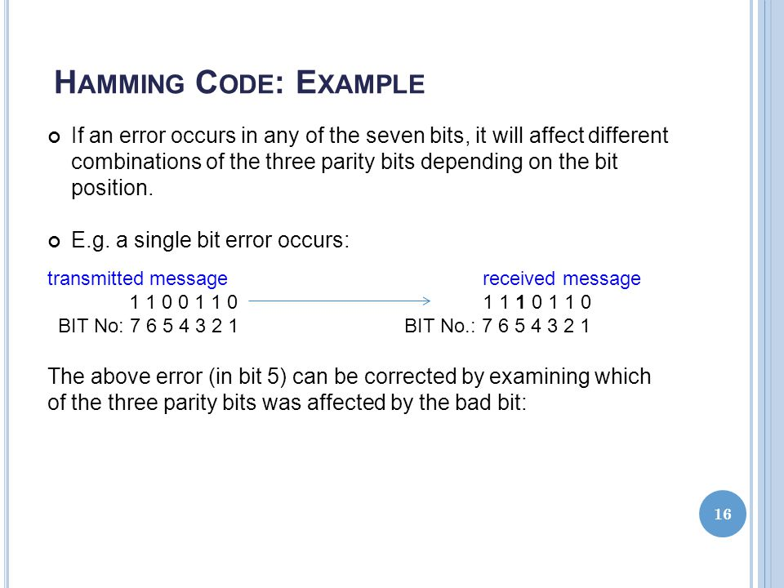

Slide 41
1.15 CODE CONVERSION:
TYPES-
Decimal to BCD (Binary Coded Decimal).
Binary to BCD.
BCD to Binary.
BCD to XS-3(Excess-3).
XS-3 (Excess-3) to BCD.
Binary to Gray.
Gray to Binary.

Slide 42
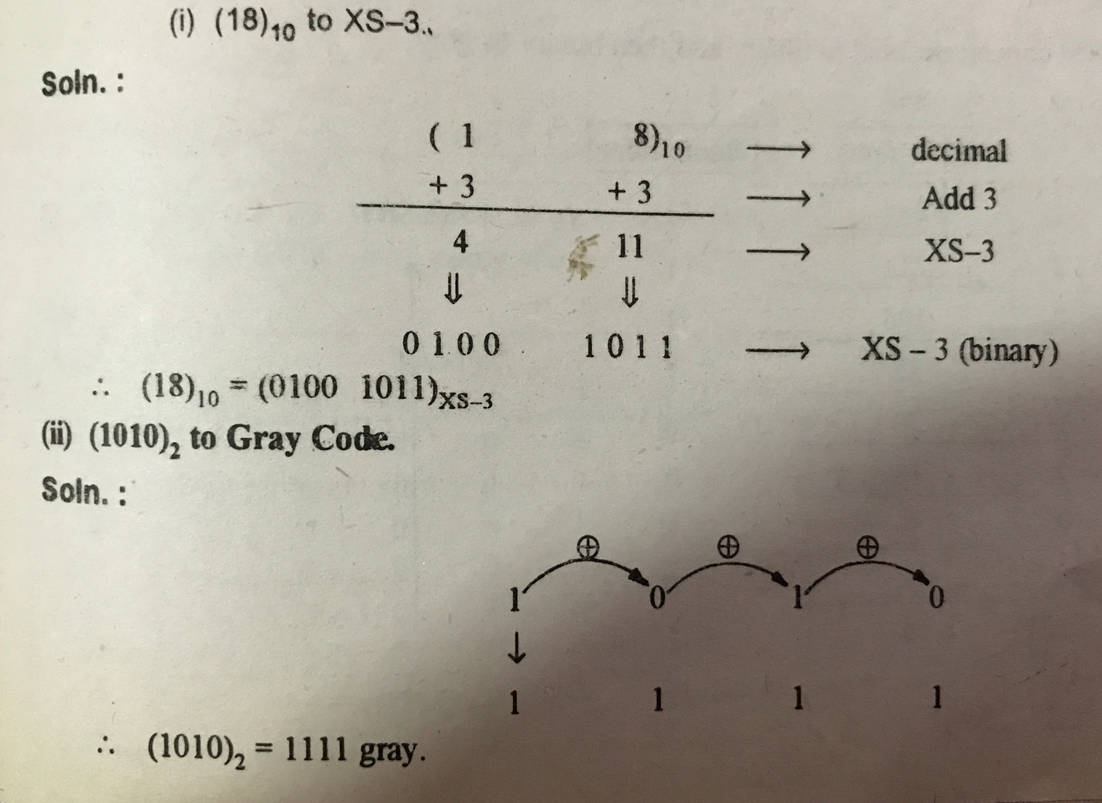

Slide 43
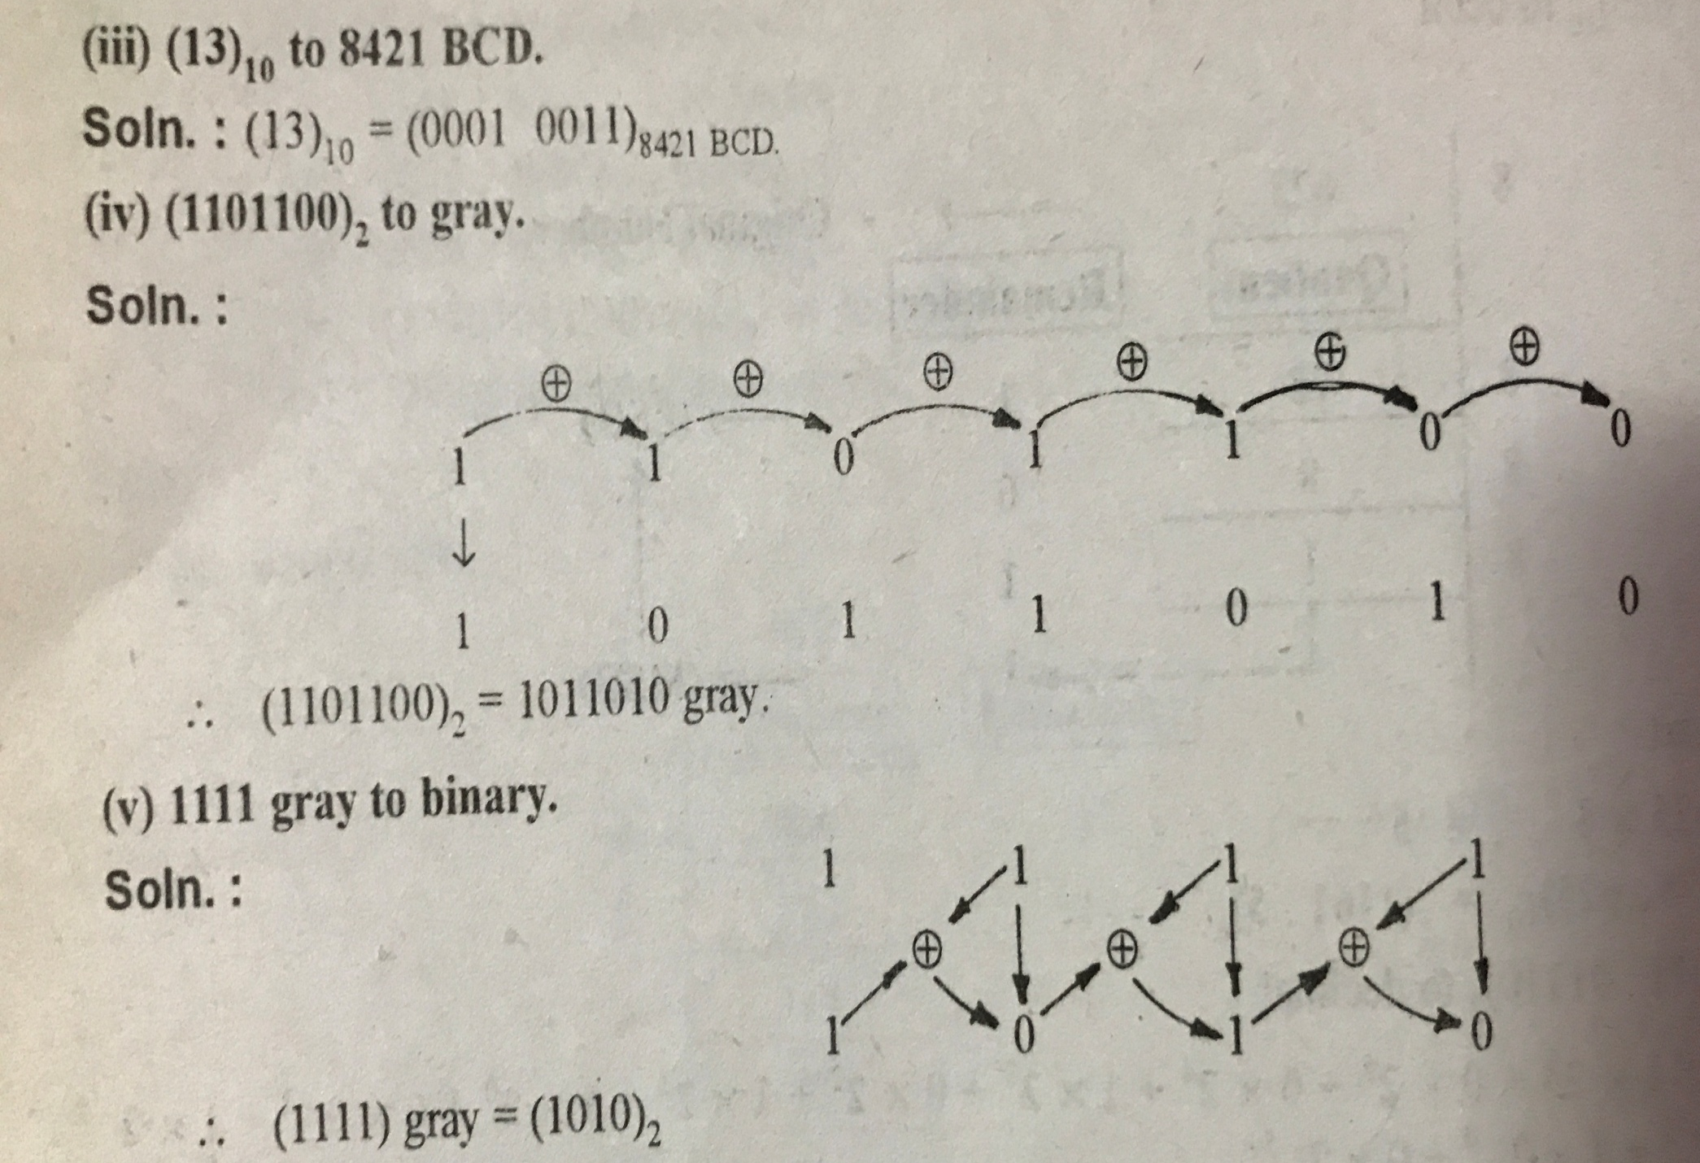

Slide 44
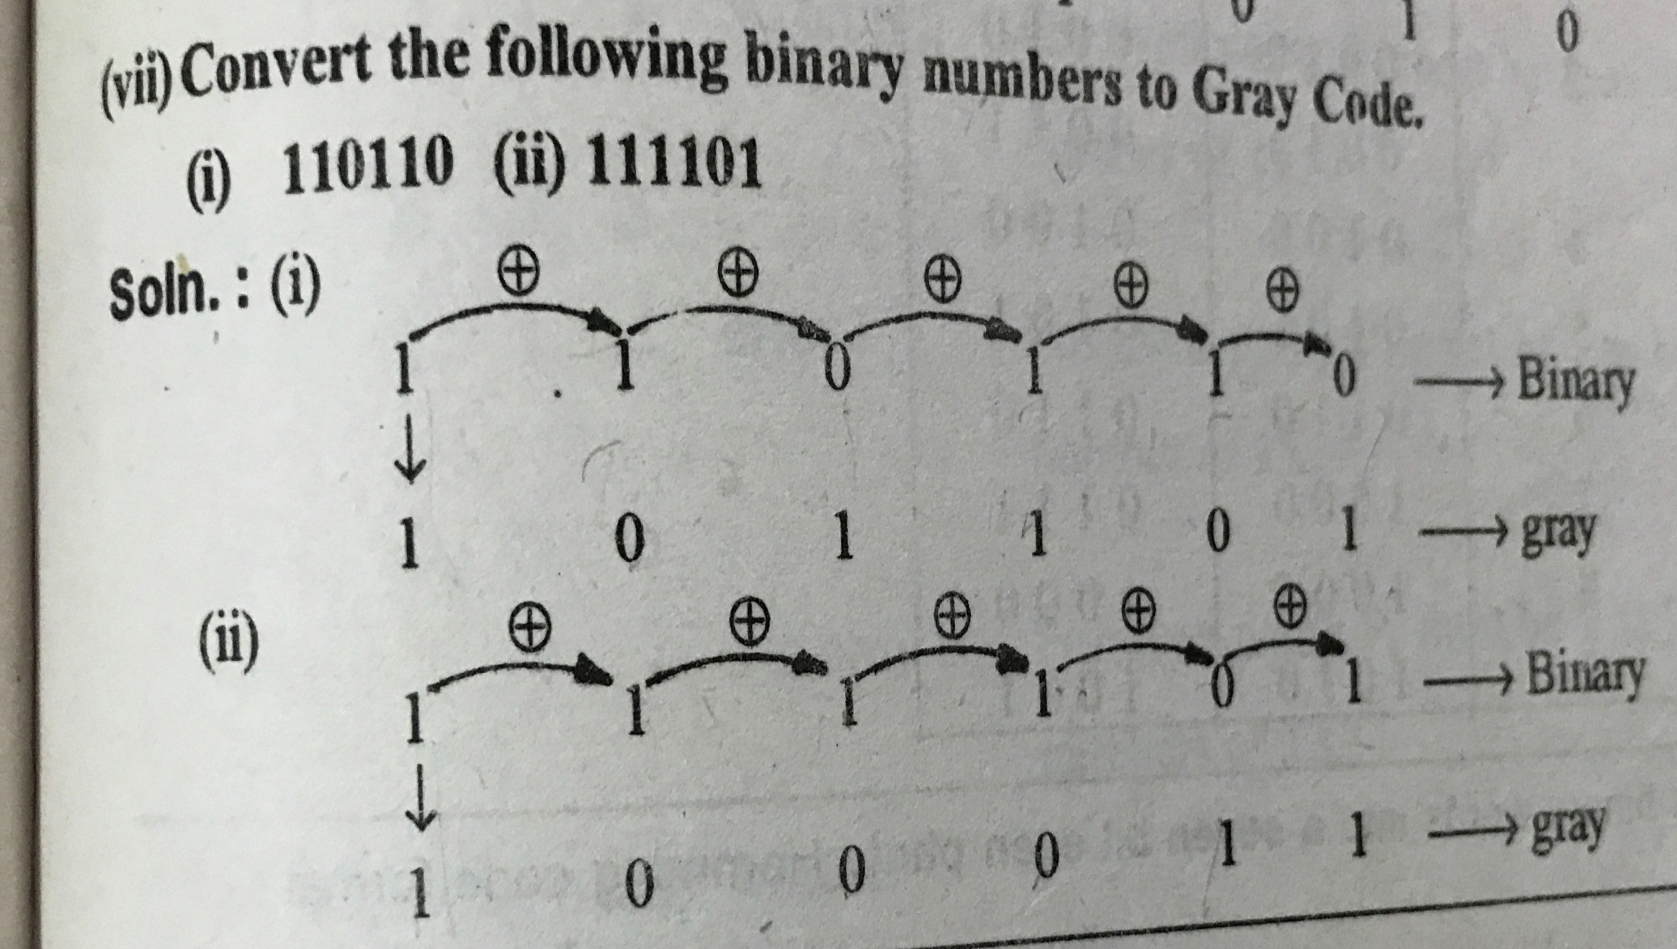

Slide 45
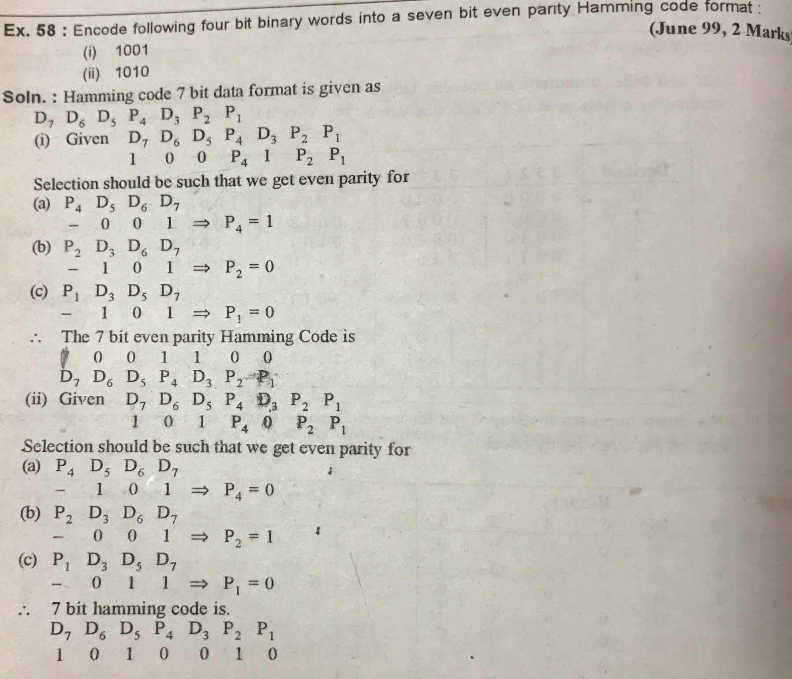

Slide 46
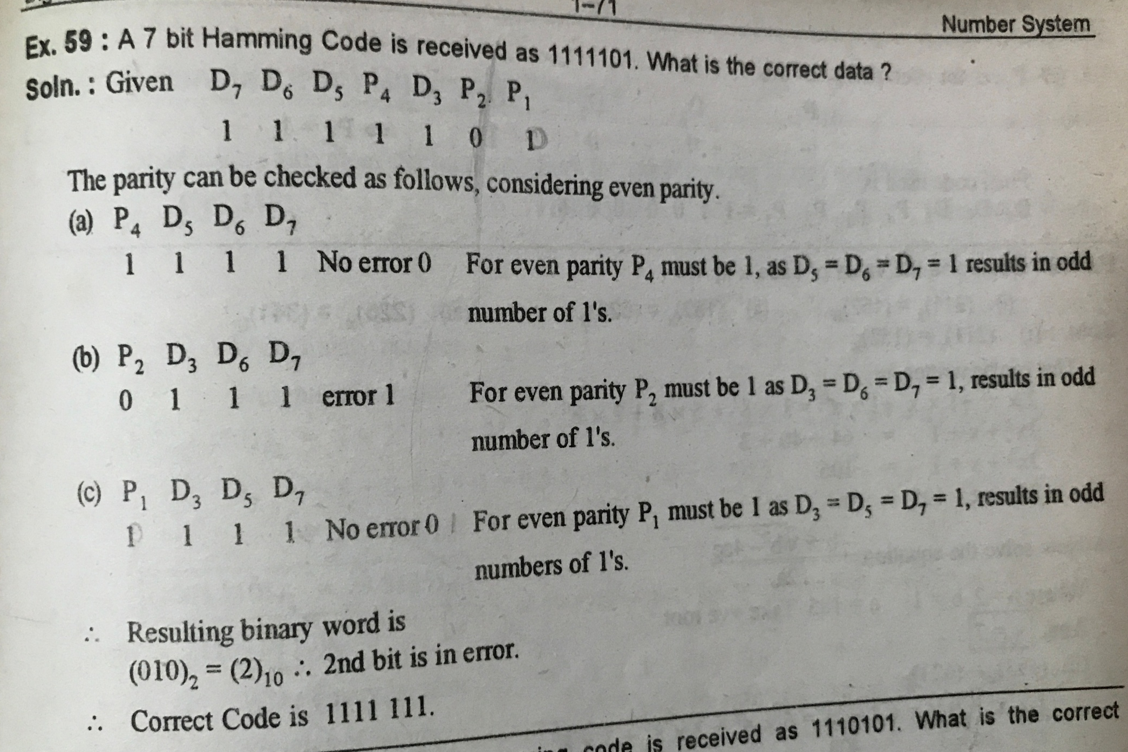

Slide 47
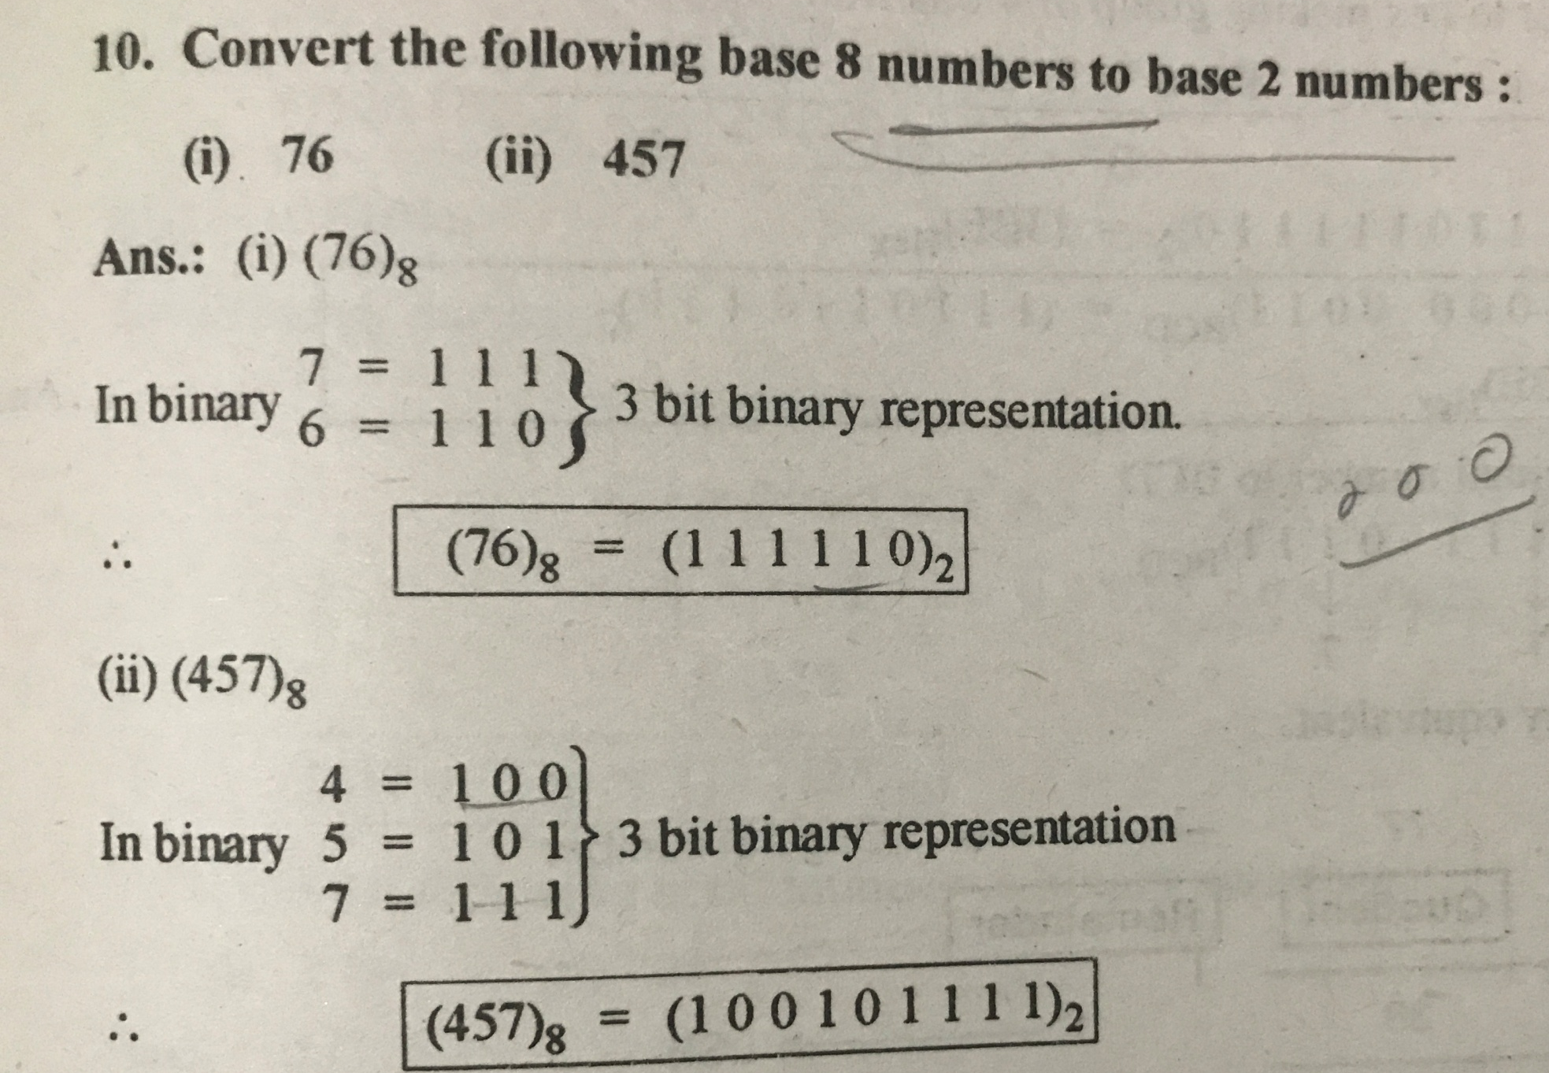

Slide 48
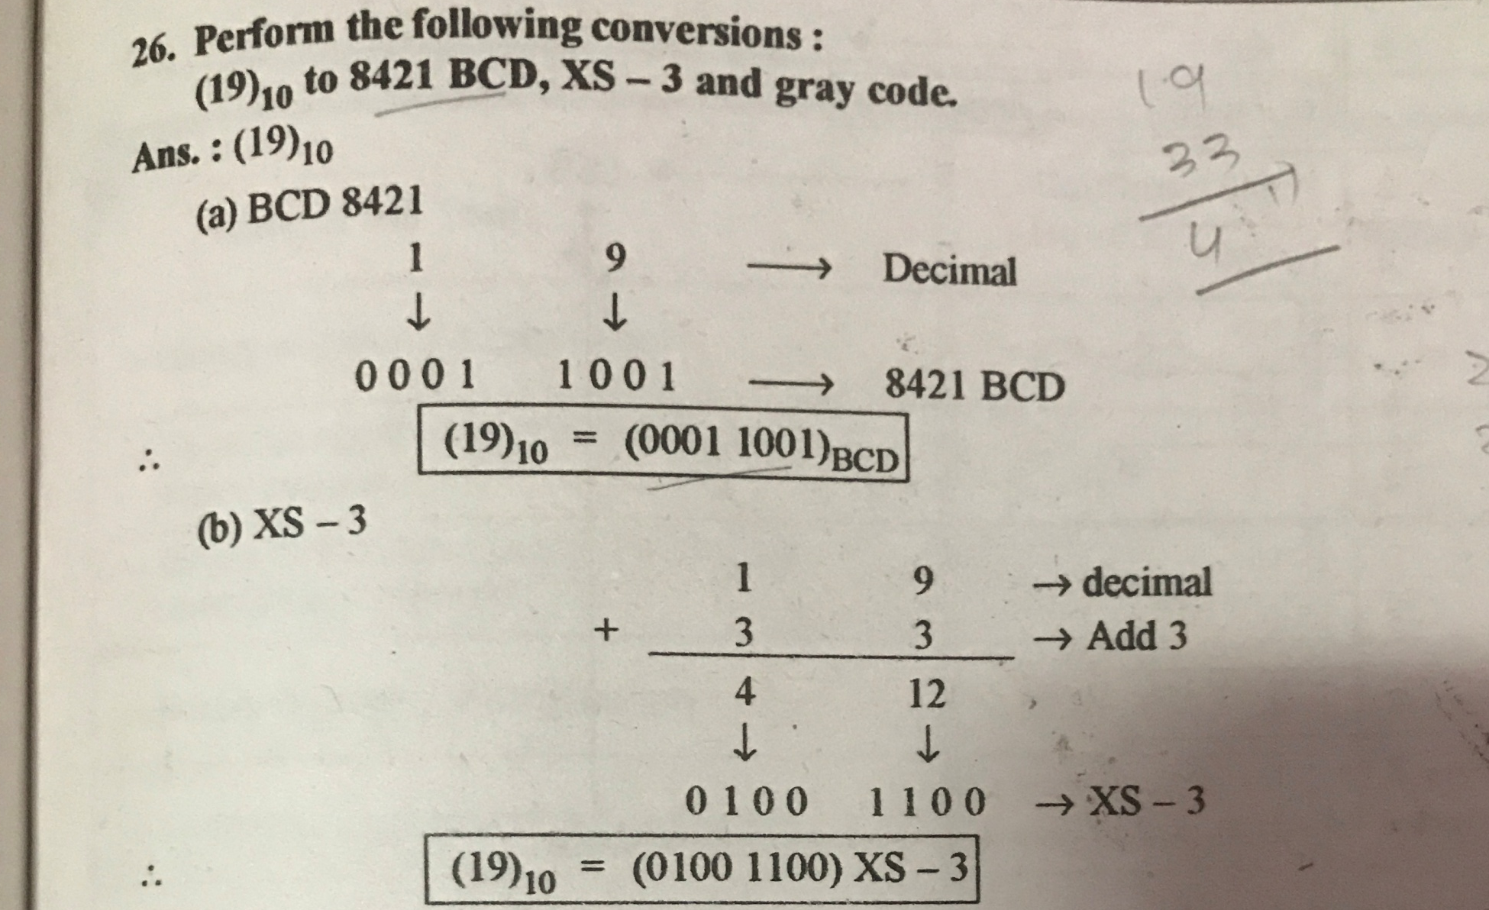

Slide 49
